Slide 1


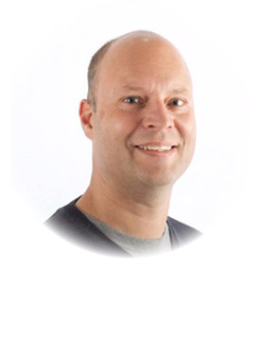
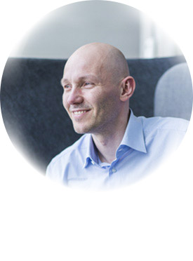
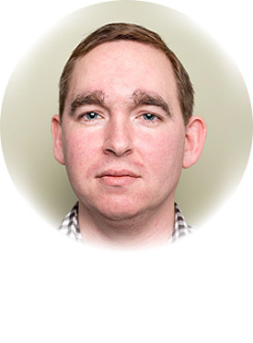
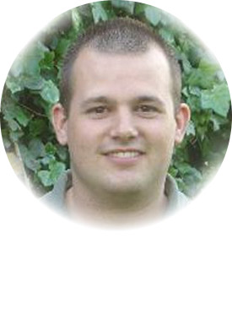
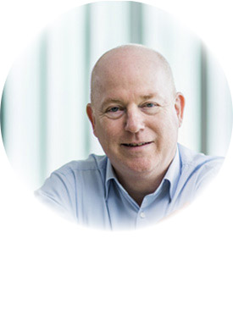

Global Organizers
Martin Abbott
Glenn Colpaert
Steef-Jan Wiggers
Tomasso Groenendijk
Eldert Grootenboer
Sven Van den brande
Gijs in ‘t Veld
Rob Fox

Slide 2

From our sponsor

Slide 3


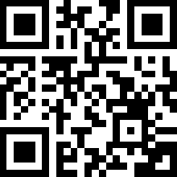

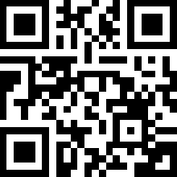
From our sponsor
Atomic Scope Gold 1 Month Free
https://bit.ly/2IPOjr8
BizTalk360 Platinum 1 Month Free
https://bit.ly/2FZSKSB
ServiceBus360 Gold 2 Months Free
https://bit.ly/2GiRGJ4

Slide 4
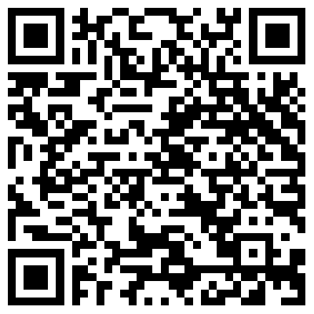
Labs
https://github.com/GlobalIntegrationBootcamp/GlobalIntegrationBootcamp/tree/master/2018/Labs

Slide 5
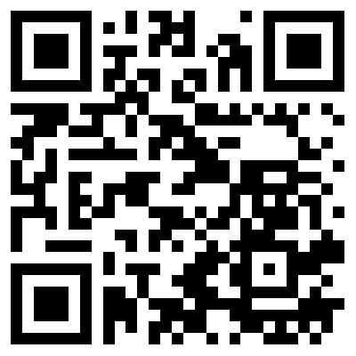
BizTalk Server Open Source Community
https://github.com/BizTalkCommunity

Slide 6

Please fill out the survey!
http://bit.ly/2ptjRdL

